Slide 1
Numerical Linear Algebra meets Machine Learning
Fabian Koffer, Simon Hanselmann, Yannick Funk,
Dennis Leon Grötzinger, Anna Ricker

Slide 2
Overview
Goal: using Machine Learning to classify the best solving algorithm for the given matrix
Notes:
employing neural networks for the linear system,

Slide 3
Most important features
Cross-platform compatible
Using a deep neural network for the classification
Multiple access points to the various levels of our software
Notes:
Linux, Windows

Slide 4
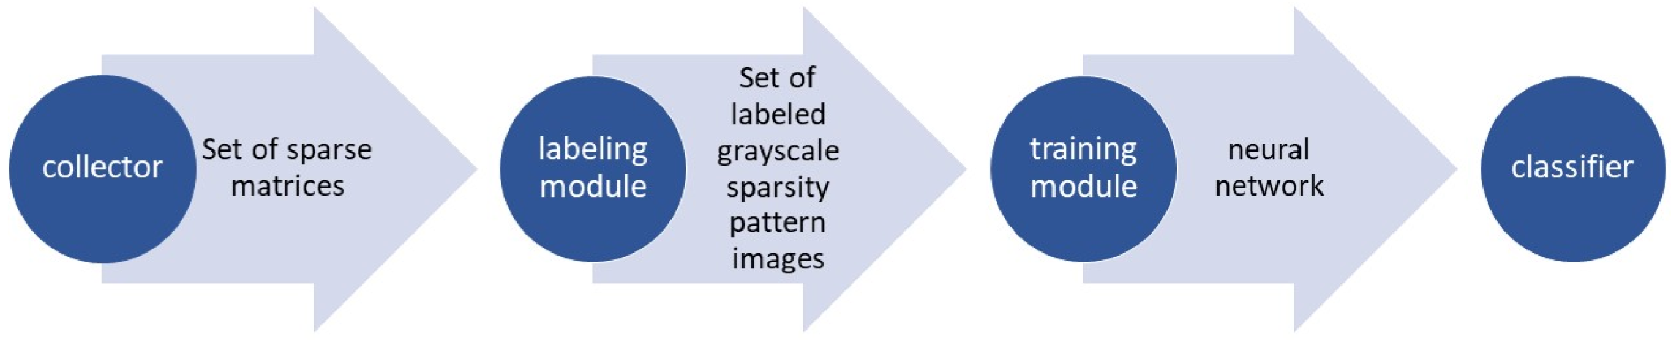
The four components
Notes:
Four individual modules, main module: classifier -> receive fastest iterative solver
generate or generate and fetch
Greyscale image
Randomizing, more traing and test data
Greyscale image again

Slide 5
Demarcation criteria
No other than square matrices will be supported
Only existing algorithms are available
Just the collection of Suite Sparse matrices and artificial generated matrices are supported

Slide 6
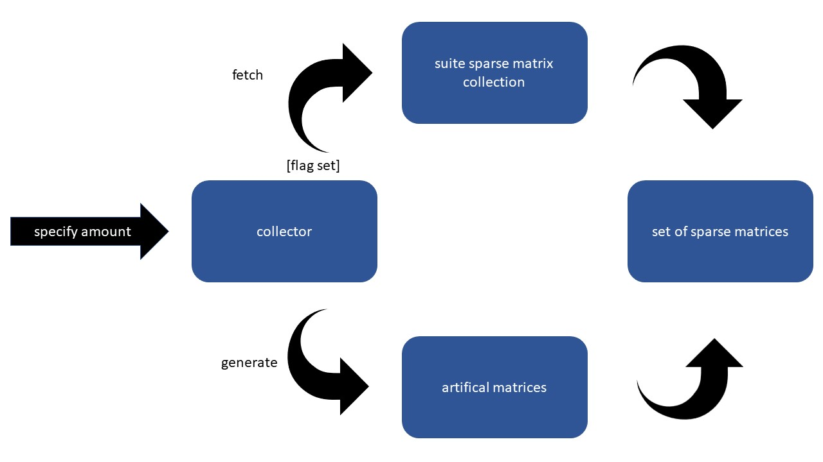
Matrix collection
Notes:
Collector: suite sparse and artificial generated

Slide 7
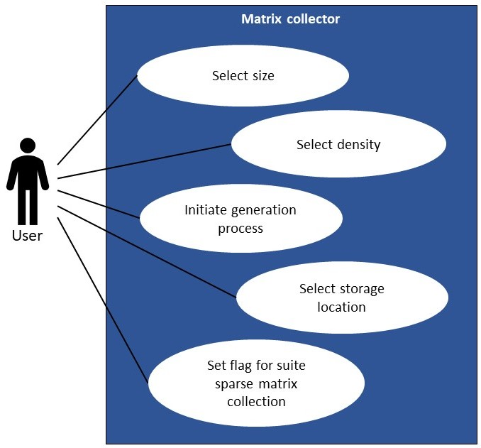
Notes:
Functional requirements:
Generation of matrices by a given sparsity level and size
Choice to either generate or generate and fetch from Suite Sparse collection

Slide 8
The command-line
collect -a <amount> -n <name> -s <size> -d <density> -p <path> -g
-a amount of matrices the user wants to generate
-n name under which the matrices will be saved
-s size (optional) the generated square matrices should have
-d density (optional) level of matrices (float between 0 and 1)
-p path (optional) where the created/downloaded matrices will be saved
-g (optional) (flag) If set it downloads as many matrices of that size as possible from Suite Sparse matrix collection
Notes:
Global test cases showed with command line:
Error statements:
Arguments are missing or invalid (especially size)
Right size and sparsity
Squared matrix
Specific name is already taken
No internet connection but –g is set
Path is not a valid path

Slide 9
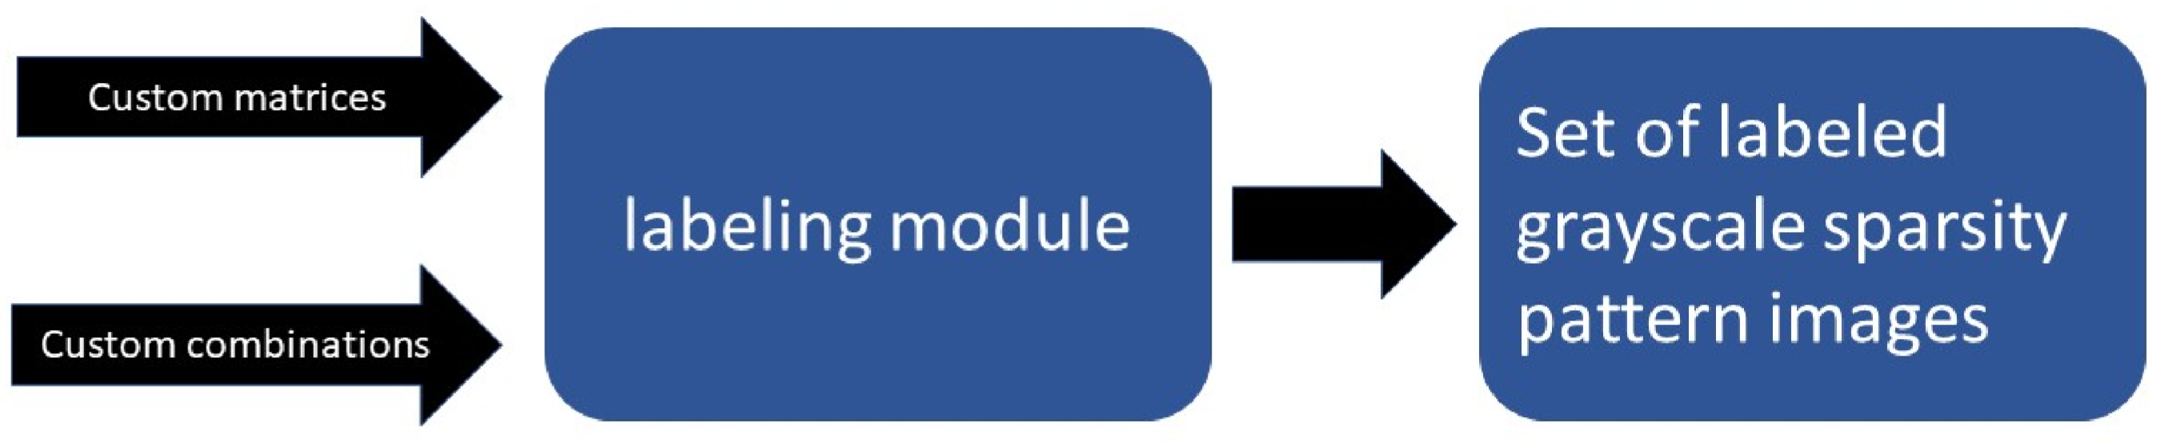
Matrix Labeling

Slide 10
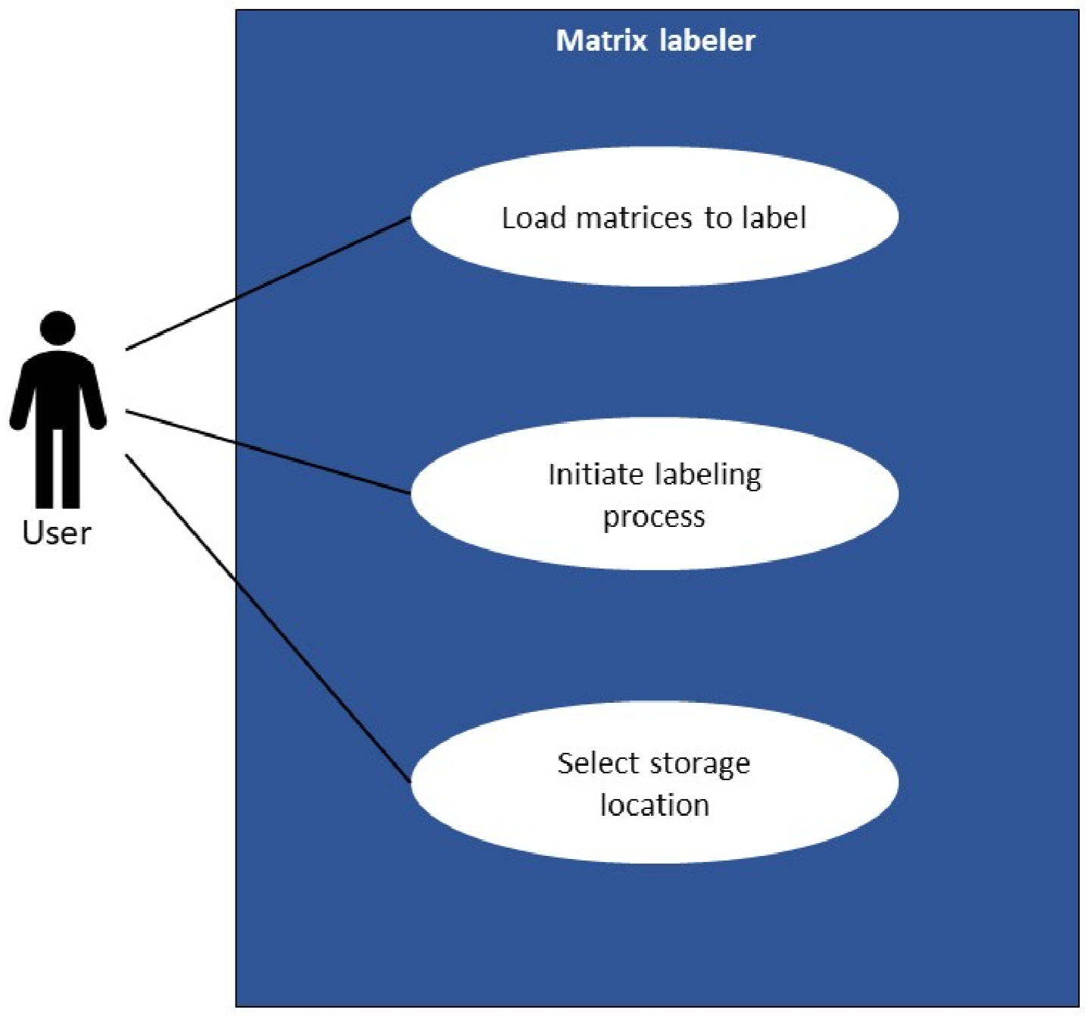
Notes:
Functional requirements:
-Determination of the best solving algorithm by time (optional custom algorithms)
-creating grayscale sparsity pattern image (all the same size!)
-saving image with label

Slide 11
The command-line
labeler label -p <path> -n <name> -s <saving path>
label (command) If set, enter labeling mode
-p path to the matrices in the local storage the user wants to have labeled
-n name under which the labeled matrices will be saved
-g saving path (optional) where the labeled matrices will be saved
Notes:
(Global test cases showed with) command line:
Error statements:
-remote fetching of matrices did result an error
-arguments invalid/missing
-name is already taken
-not a valid path

Slide 12
Other commands (optional)
labeler list:
Prints a list of available and used algorithms
label add <algorithm>:
Adds an algorithm that will be used for labeling matrices
label remove <algorithm>:
Removes an algorithm from the list of used algorithms

Slide 13
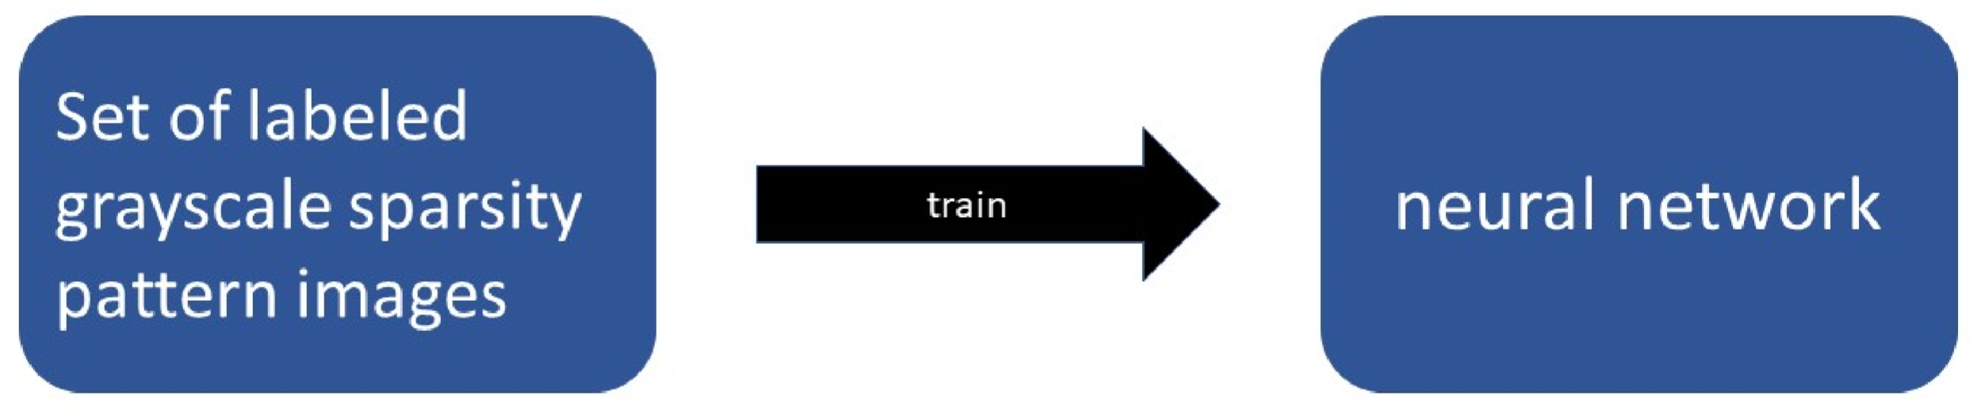
Deep neural network Training and Testing

Slide 14
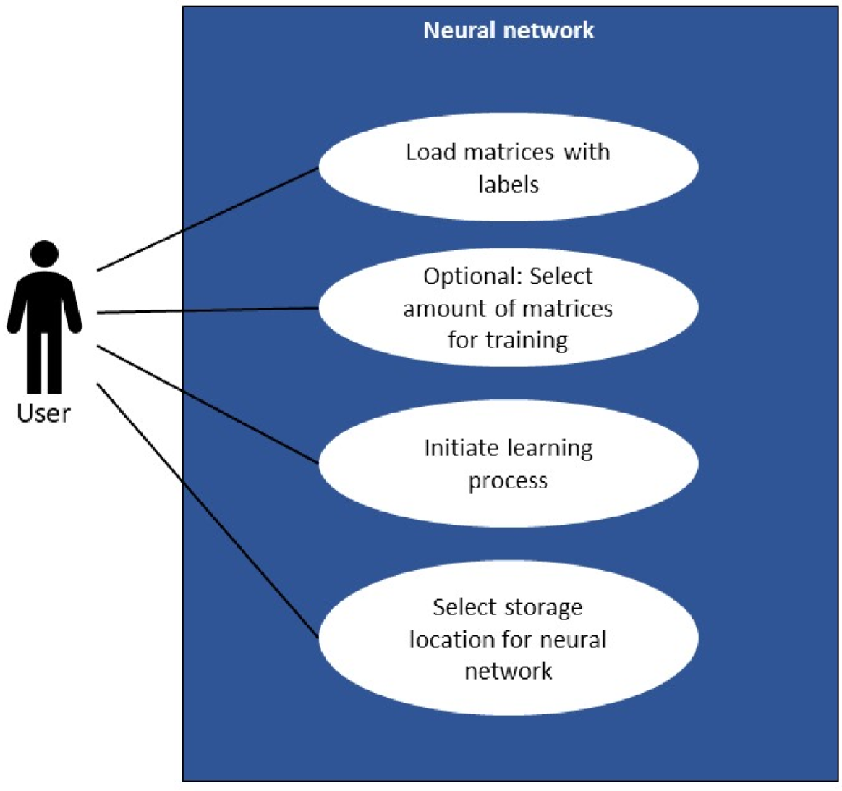
Notes:
Functional requirements:
-randomizing matrices -> different order
-more training than test data -> separation (testing on test and training on train data)
- Neural network saved after every iteration

Slide 15
The command-line
train -p <path> -n <name> -t <train> -s <saving path>
-p path to the labeled matrices on the local storage
-n name under which the neural networks will be saved after training has finished
-t train (optional) (float between 0 and 1) percentage of matrices used for training
-s saving path (optional) where the neural network state will be saved
Notes:
Global test cases showed with command line:
Error statements:
Matrices have wrong format or are not labeled
Name is already taken
Not a valid path
Arguments are missing/invalid
Print:
Accuracy/loss
Histogram

Slide 16
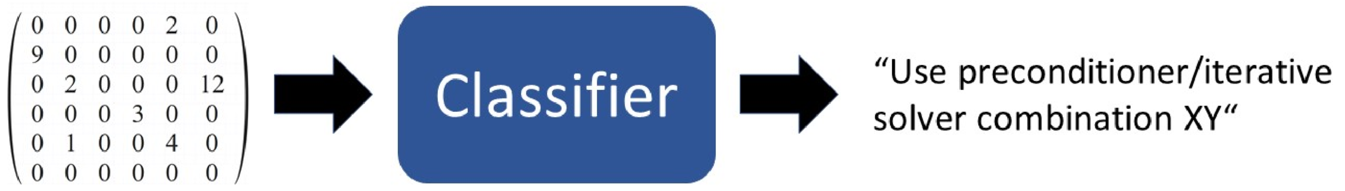
Matrix classification

Slide 17
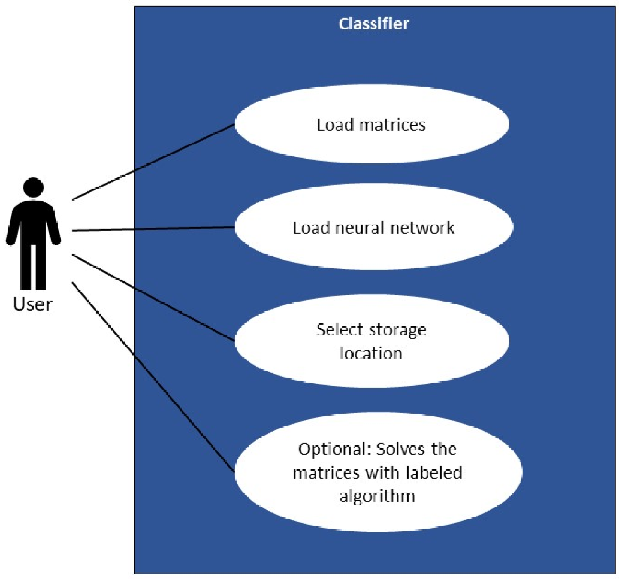
Notes:
Functional requirements:
Creating a grayscale sparsity pattern image of the input matrix
Loading neural network
Classification

Slide 18
The command-line
classify -p <path> -n <network> -s
-p path to the matrix the user wants to classify
-n network (optional) path to the trained neural networks
-s (optional) (flag) if set matrix will also be solved after classification
Notes:
Global test cases showed with command line:
Error-statements:
-wrong matrix format
-NN path is wrong
-arguments are missing or invalid

Slide 19
Summary
Collect matrices
Label the collected matrices
Train a neural network with labeled matrices
Classify given matrices based on the neural network

